Slide 1

Data Science
for Business

Slide 2

For companies to become competitive and skyrocket their growth, they need to leverage AI/ML to develop predictive models to forecast sales in the future.
Predictive models attempt at forecasting future sales based on historical data while taking into account seasonality effects, demand, holidays, promotions, and competition.
In this project, you work as a data scientist in the sales department and the sales team provided you with data from 1115 stores.
The objective is to predict future daily sales based on the features.

Slide 3
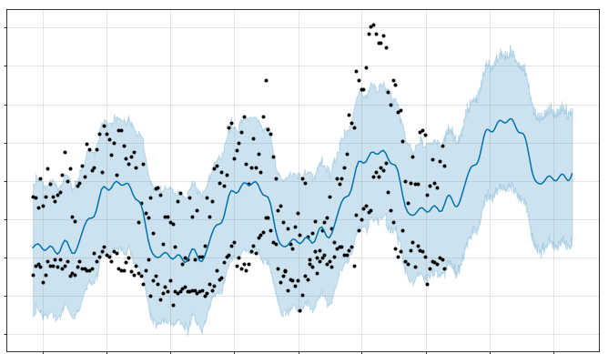
FUTURE
PAST
SALES
TIME

Slide 4
INPUTS AND EXPECTED OUTPUT
Id: transaction ID (combination of Store and date)
Store: unique store Id
Sales: sales/day, this is the target variable
Customers: number of customers on a given day
Open: Boolean to say whether a store is open or closed (0 = closed, 1 = open)
Promo: describes if store is running a promo on that day or not
StateHoliday: indicate which state holiday (a = public holiday, b = Easter holiday, c = Christmas, 0 = None)
SchoolHoliday: indicates if the (Store, Date) was affected by the closure of public schools

Slide 5
INPUTS AND EXPECTED OUTPUT
StoreType: categorical variable to indicate type of store (a, b, c, d)
Assortment: a = basic, b = extra, c = extended
CompetitionDistance (meters): distance to closest competitor store
CompetitionOpenSince [Month/Year]: date when competition was open

Slide 6
INPUTS AND EXPECTED OUTPUT
Promo2: Promo2 is a continuing and consecutive promotion for some stores (0 = store is not participating, 1 = store is participating)
Promo2Since [Year/Week]: date when store started participating in Promo2
PromoInterval: describes the consecutive intervals Promo2 is started, naming the months promotion is started anew. E.g. "Feb,May,Aug,Nov" means each round starts in February, May, August, November of any given year for that store

Slide 7
FACEBOOK PROPHET
Prophet is open source software released by Facebook’s Core Data Science team.
Prophet is a procedure for forecasting time series data based on an additive model where non-linear trends are fit with yearly, weekly, and daily seasonality, plus holiday effects.
Prophet works best with time series that have strong seasonal effects and several seasons of historical data.
For more information, please check this out:
https://research.fb.com/prophet-forecasting-at-scale/
https://facebook.github.io/prophet/docs/quick_start.html#python-api

Slide 8
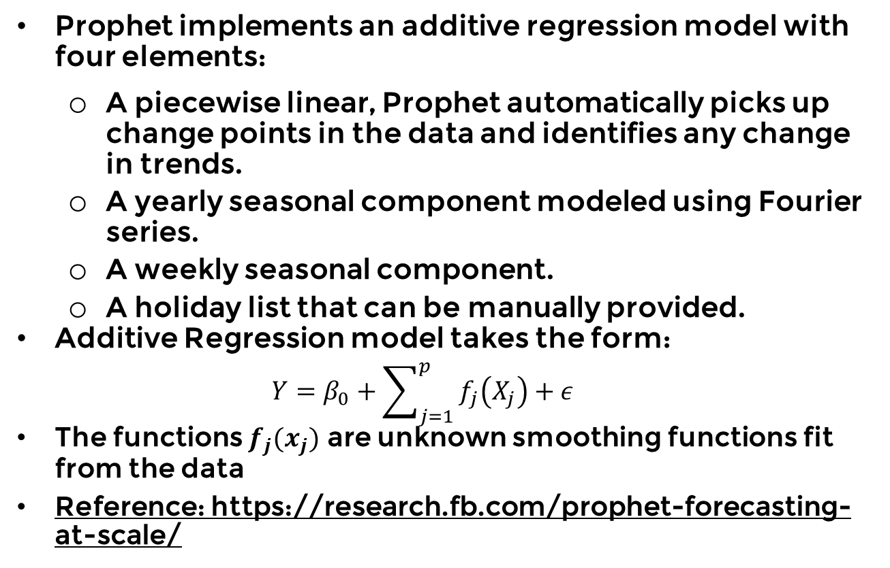
FACEBOOK PROPHET
Prophet implements an additive regression model with four elements:
A piecewise linear, Prophet automatically picks up change points in the data and identifies any change in trends.
A yearly seasonal component modeled using Fourier series.
A weekly seasonal component.
A holiday list that can be manually provided.
Additive Regression model takes the form:
$$Y=β_{0}+\sum_{j=1}^{p}{f_{j}\left(X_{j}\right)+ε}$$
The functions $f_{j}(x_{j})$ are unknown smoothing functions fit from the data
Reference: https://research.fb.com/prophet-forecasting-at-scale/

Slide 9
FACEBOOK PROPHET
ACCURATE AND FAST
Facebook teams uses Prophet for accurate forecasting and planning.
AUTOMATIC
No need to perform data preprocessing.
Prophet can generate results in seconds.
Prophet works with missing data with several outliers.
DOMAIN KNOWLEDGE INTEGRATION
Users can tweak forecast by manually adding domain specific knowledge.

